Slide 1
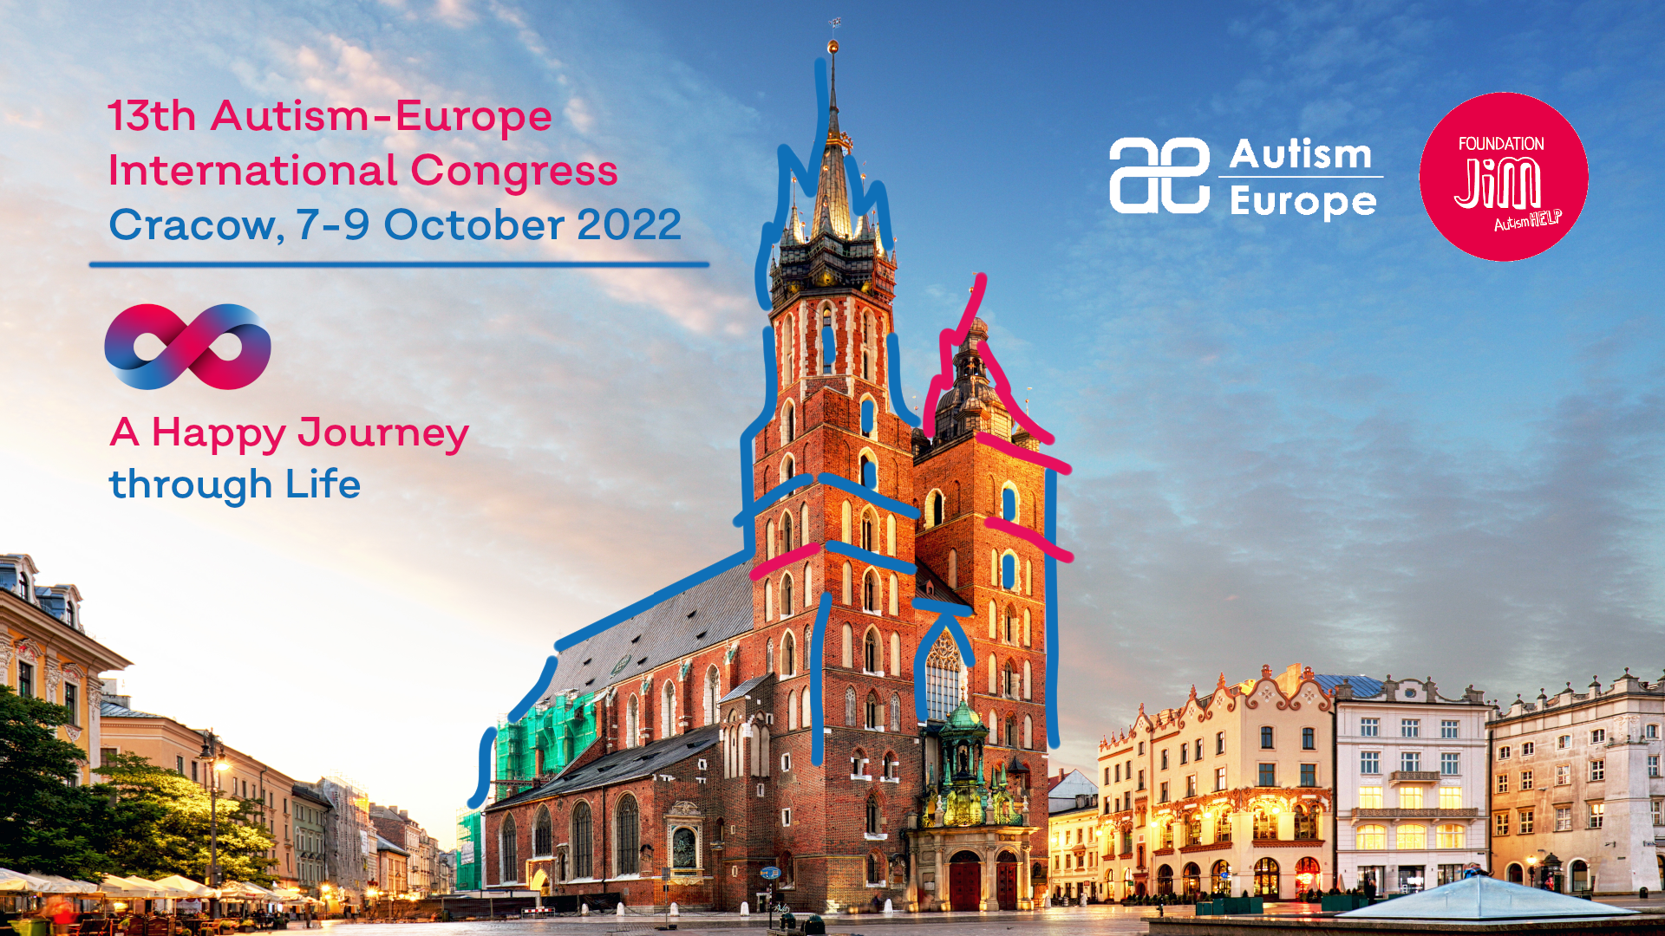
Your Topic

Slide 2

Your Topic

Slide 3




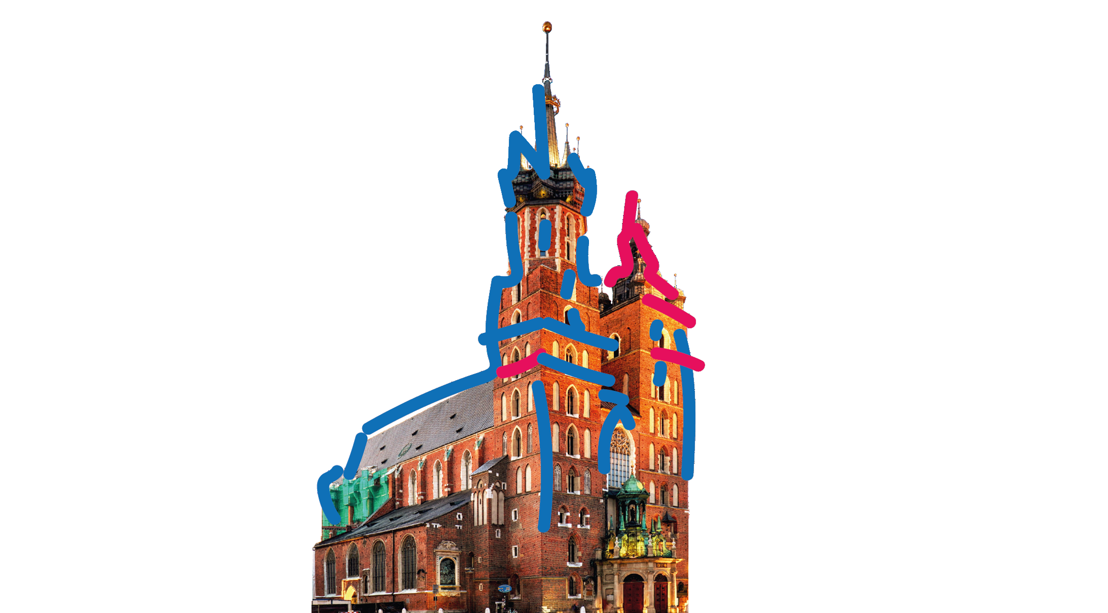






Autism-Europe Congress Cracow 2022
Feel free to use the following graphics in your presentation:

Slide 4
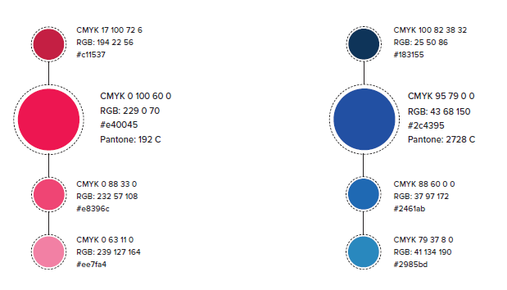
Autism-Europe Congress Cracow 2022
Feel free to use the following colors in your presentation:
You can use these colors:
#c11537
#e40045
#e8396c
#ee7fa4
#183155
#2c4395
#2461ab
#2985bd

